Slide 1
Syllabus IHE Groundwater Flow Transient Analytical Solutions
Prof.dr.ir.T.N.Olsthoorn, 2020-2024
tolsthoorn@gmail.com
+31-620440256

Slide 2
Introduction
Objectives
Exercises
Irreversible and reversible transient groundwater phenomenae
Transient one-dimensional flow (cross sections)
Transient flow to wells (axial symmetric flow)

Slide 3
Transient groundwater flow:
Can exist only if some form of storage is available
Without storage pressures would spread at (almost) infinite speed, implying that the flow system would be steady
Every physical system shows at least initially some dynamics in storing energy, momentum or mass and in our case: water
Notice that “storage” can be positive or negative (“retrieval”); mathematically it is the same, just the sign is different

Slide 4
Groundwater systems
Without recharge, a groundwater system gradually drains towards its boundaries. The drainage time is characteristic for that system and can be short or long:
Some groundwater systems react fast; their equilibrium is reached in days to weeks.
Some systems react extremely slowly; it may take hundreds or even thousands of years before an equilibrium is finally reached
For example: Kalahari, drainage takes > 10000 years
Other example: A small parcel between ditches, 2 days

Slide 5
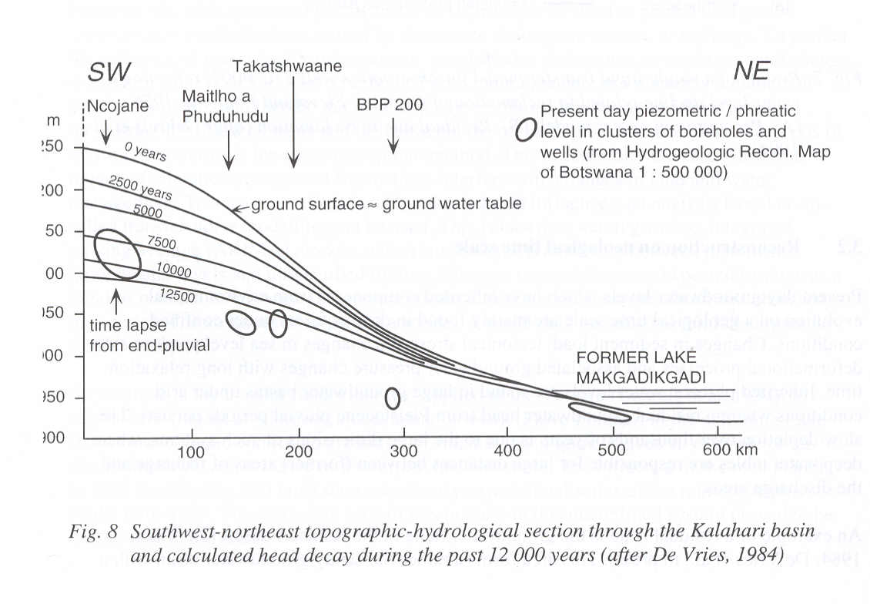
Natural drainage of the Kalahari Desert since previous wet episode

Slide 6
Forms of subsurface water storage
Irreversible storage
Liquefaction
Subsidence (consolidation)
Over-extraction of fresh water causing intrusion and upconing of saltwater in an aquifer (almost irreversible, i.e. may take centuries to restore).
Reversible storage
Water table storage
Elastic storage

Slide 7
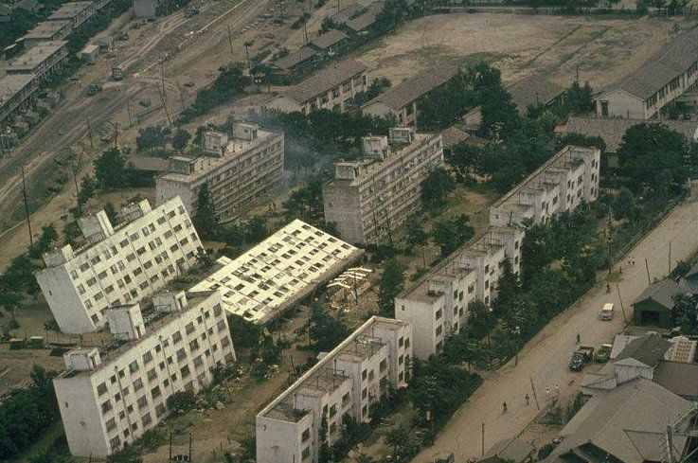
Liquefaction
https://www.scienceworld.ca/resource/liquefaction/

Slide 8
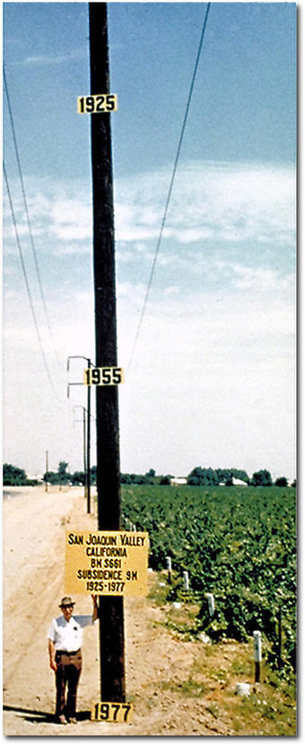
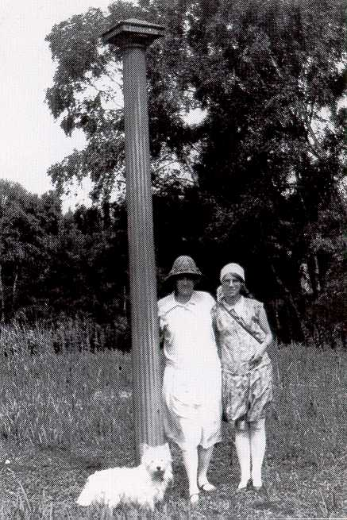
Subsidence

Slide 9
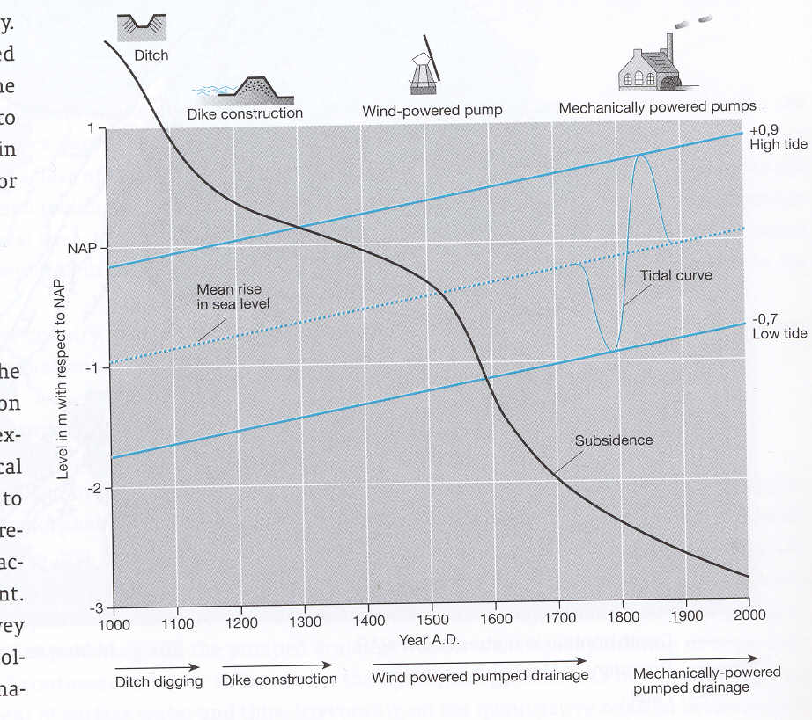

Slide 10
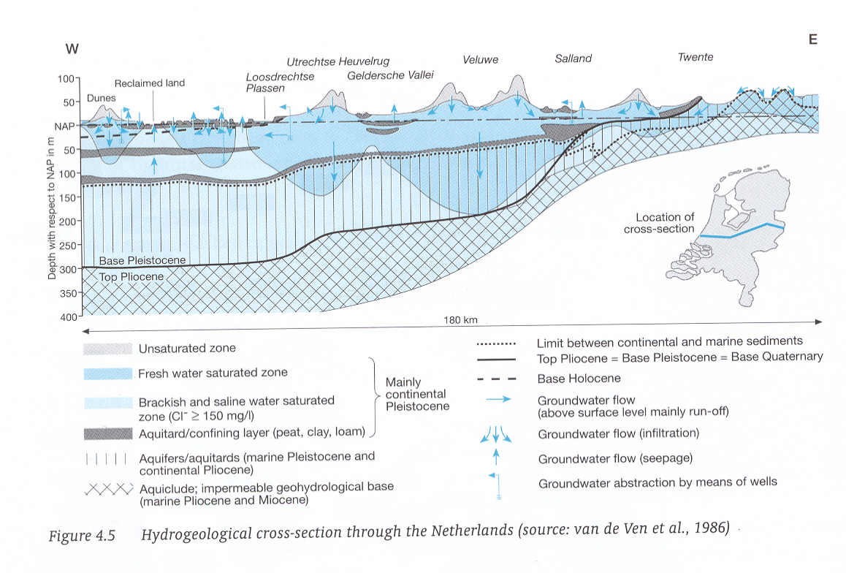
Fresh water floating on salt water

Slide 11
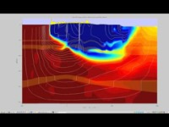
Amsterdam Water Supply Dunes cross section

Slide 12
Questions
See section 3.4 of the syllabus
See old exams bundle. First question in each of the exams)

Slide 13
Chapter 4 Forms of reversible storage
Water-table / phreatic storage
Elastic storage

Slide 14
Variations in storage of water in aquifers are possible because
Storage of water above the water table in the unsaturated zone (emptying and filling of pores)
Elastic behavior of water, grains and especially the porous matrix as a whole
Sometimes: compression of gas, e.g. in petroleum engineering or when gas is formed in the subsurface e.g. by biochemical reactions (CH4)

Slide 15
Section 4.1 Phreatic or water-table storage
Keywords:
Water table
Unsaturated zone
Capillary fringe / Air-entry pressure / Pore size
pF-curves / moisture profile / saturation curves
Specific yield versus (shallow) dept of water table
Porosity / Effective porosity / Specific yield / specific retention / Field capacity / Wilting point
Adhesion / Cohesion / Surface tension

Slide 16
Capillarity (as the simplest model of the unsaturated zone)
α
r
R
Meniscus
=
sphere
(
must
be
)
compare
with
half
sphere
h
p
=
−
ρ
gz
c
z

Slide 17
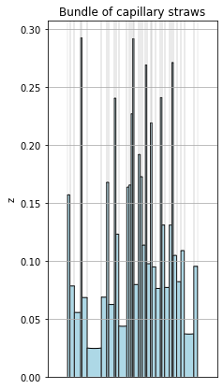
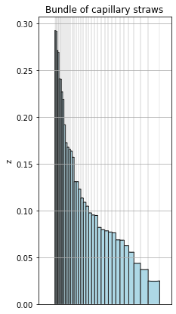
The unsaturated zone may be viewed as a set of tubes (straws) with a
distribution of widths. Capillary rise depends on tube width.

Slide 18
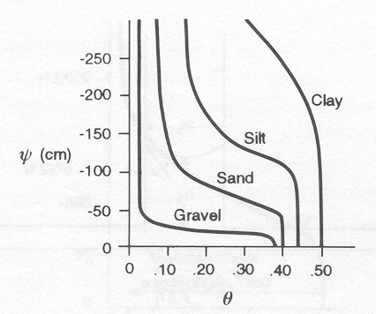
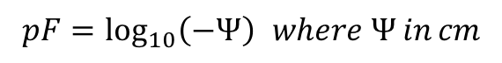
Saturation or pF curves for different materials
$$pF=\log_{10}\left(−Ψ\right) where Ψ in cm$$

Slide 19
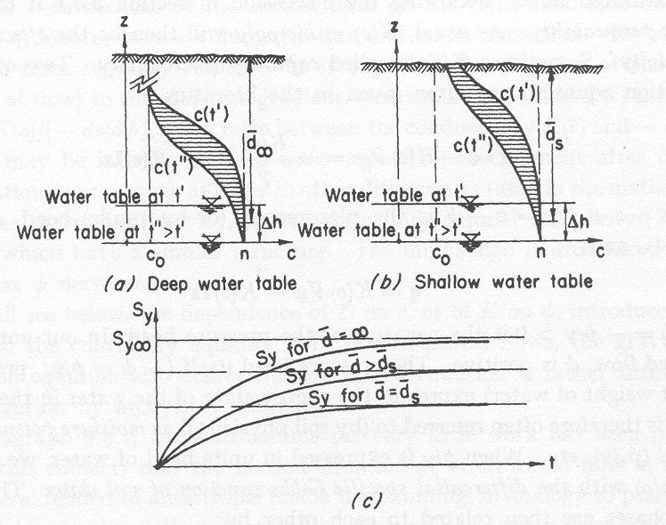
Drainage from the unsaturated zone, deep vs shallow water table
Cut-off moisture
profile
Actually drained

Slide 20
Free gravity drainage leaves some water behind → specific yield

Slide 21
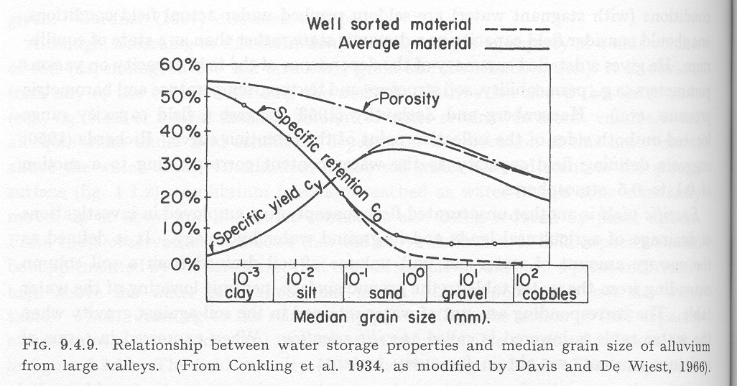
Specific yield vs specific retention. (Porosity tends to be smaller for coarser materials)

Slide 22
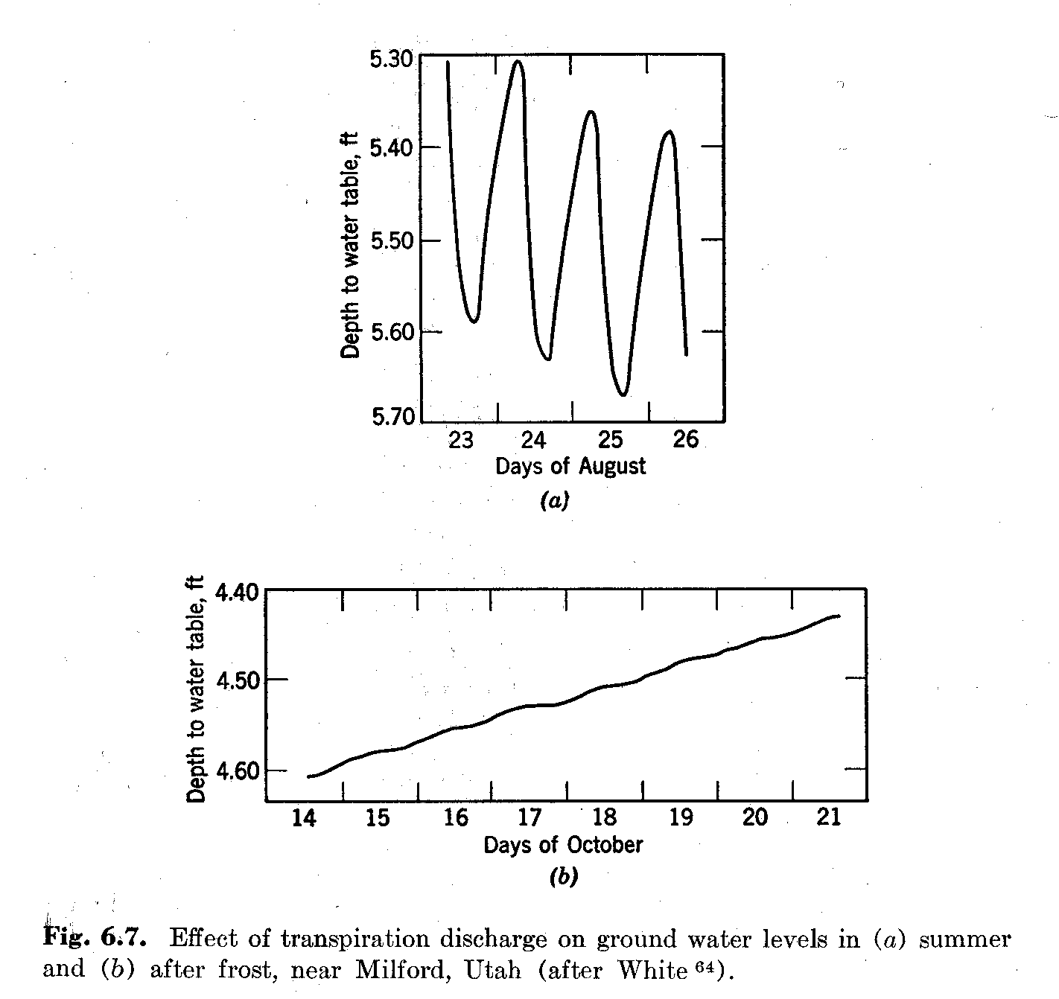
Effect of daily plant transpiration on shallow water table.

Slide 23
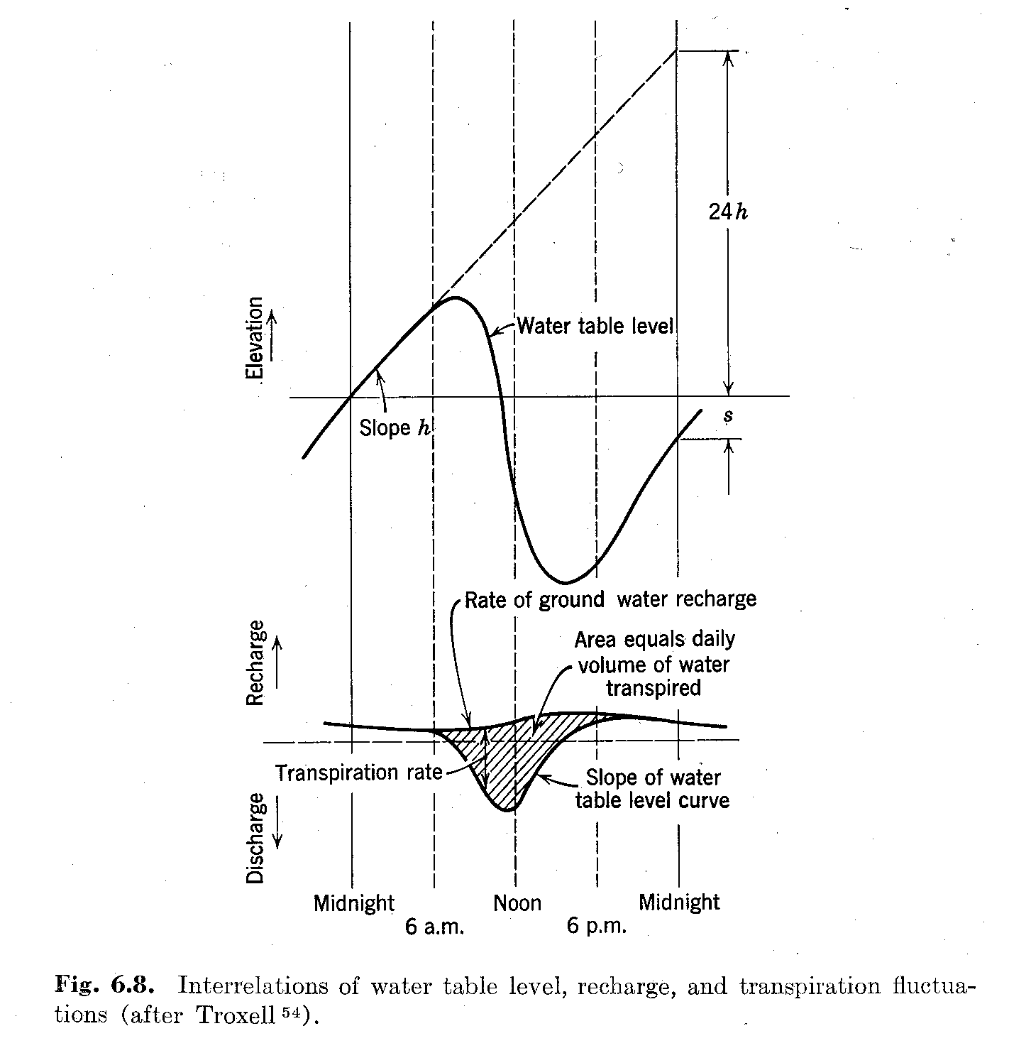
Estimation of transpiration from daily water-table fluctuation
Water table
decline in
24 hours
Trend (no transpiration during the night)
Rate of groundwater
recharge
Water table
decline in
24 hours

Slide 24
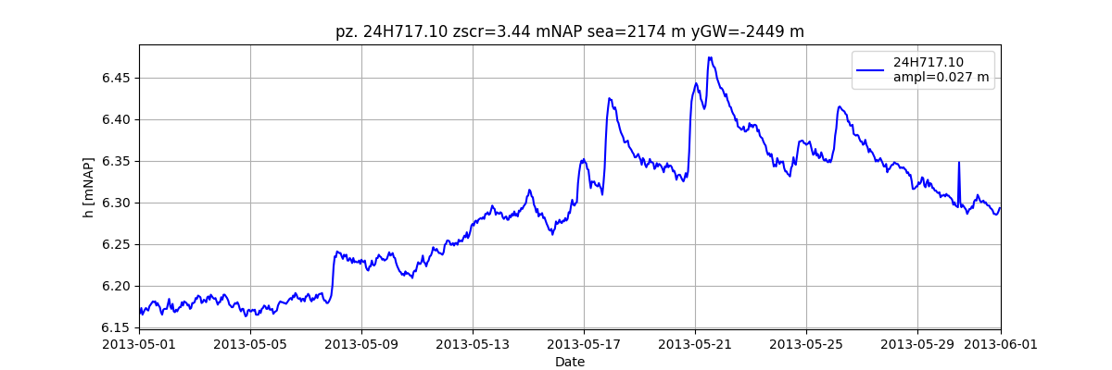
Daily evaporation can often be seen in the time series of shallow piezometers

Slide 25
Questions / exercises
See section 4.1.2 of the syllabus
See old exams bundle

Slide 26
Section 4.2 Elastic storage (semi)-confined aquifers
Keywords:
Confined and semi-confined aquifers / aquitards / aquicludes
Specific (elastic) storage S_{s} [1/L], Elastic storage of aquifer S [-]
Water pressure, Effective (grain) pressure, total pressure
Water compressibility, Porous matrix compressibility
Loading efficiency LE [-], Barometric efficiency BE [-], LE + BE = 1
(Earth tide)

Slide 27
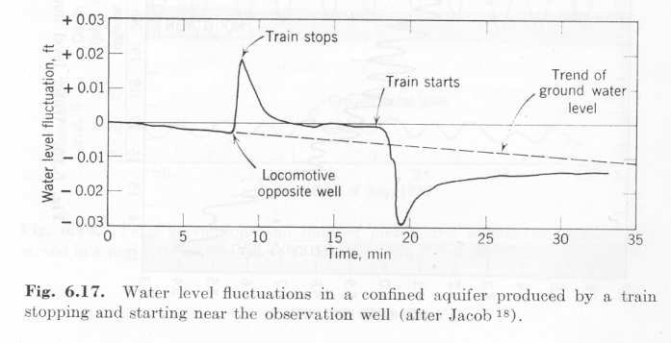
First –ever registered confined groundwater head fluctuation under varying load (i.e. a train) at ground surface

Slide 28
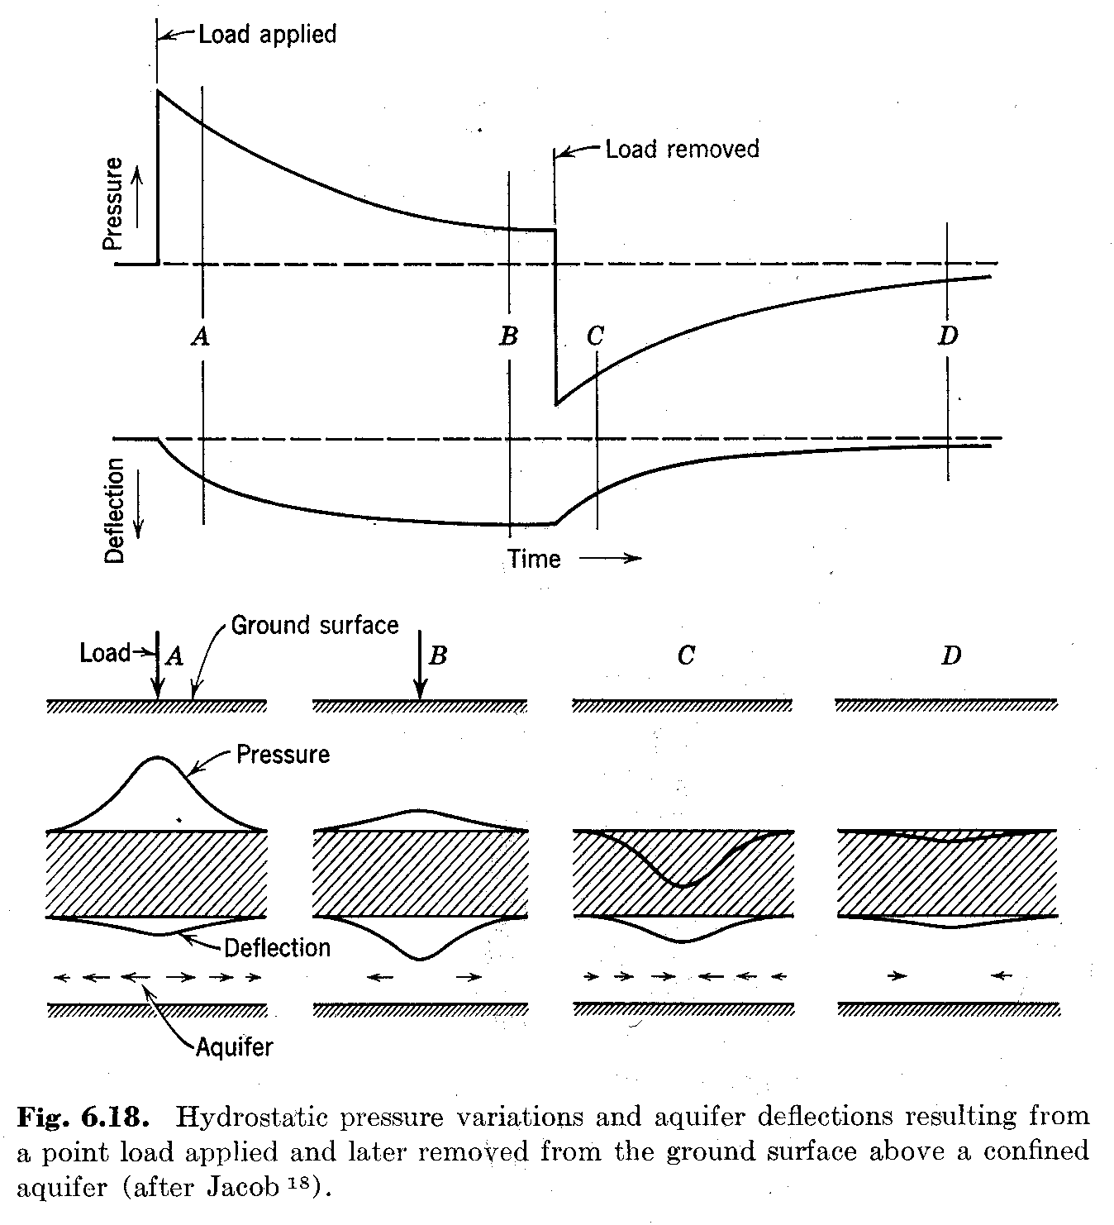
Explanation of the ”train effect”, i.e. of the effect of a varying load at ground surface on the head in a (semi)-confined aquifer.

Slide 29
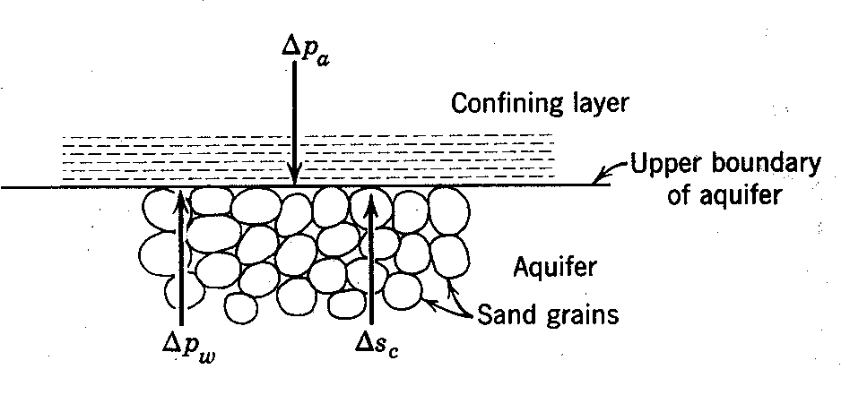
Alternative way of explaining the same thing, focusing on the changes of the water pressure and that at the porous matrix.

Slide 30
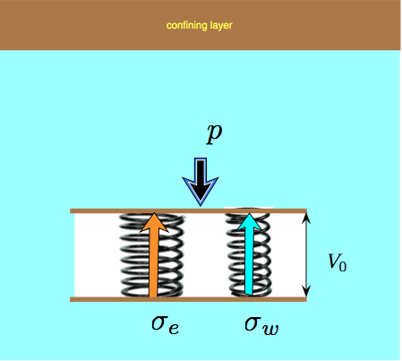
Explaining elastic storage/compression conceptually using two springs (one water, one porous matrix)

Slide 31
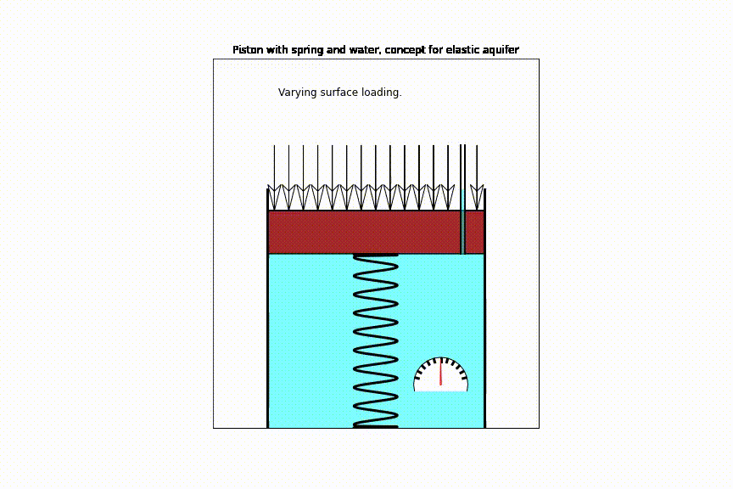

Slide 32
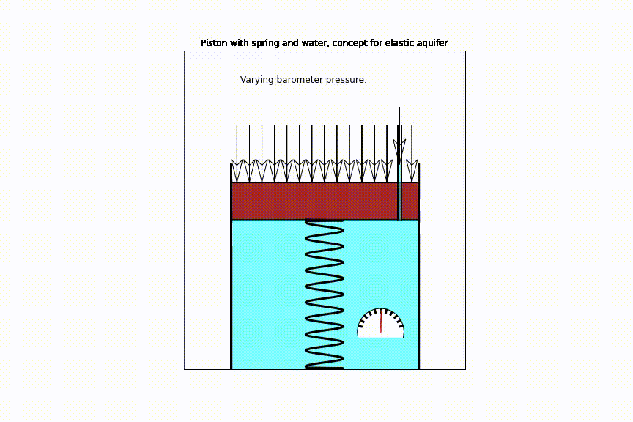

Slide 33
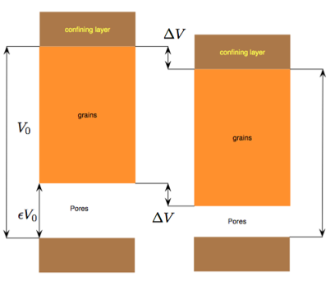
Conceptually split the pore volume from the pure grain volume (virtually uncompressible) and see why the change of aquifer volume equals the change of pore volume.

Slide 34
Pressure changes in and on the ground
Change in overburden (at ground surface)
Loading
Tides (below ocean floor, near coast)
Change in atmospheric pressure
Note: These pressure changes only affect heads in (semi)confined aquifers !

Slide 35
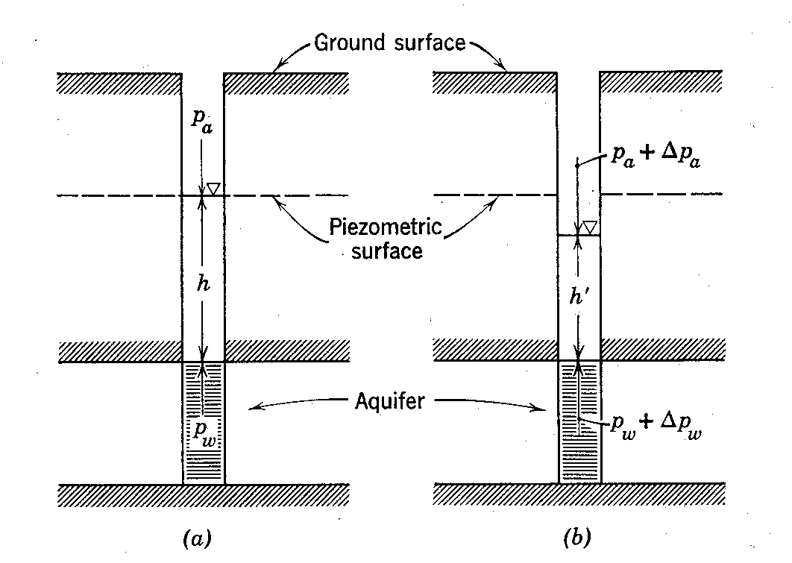
How does the barometer affect head? What’s the difference with loading at ground surface?

Slide 36
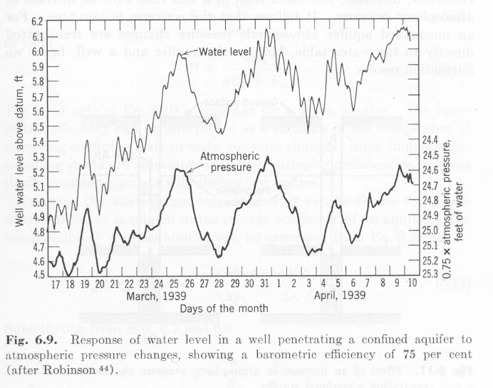
First-ever registration of barometer effect. Notice that the atmospheric axis has been reversed!

Slide 37
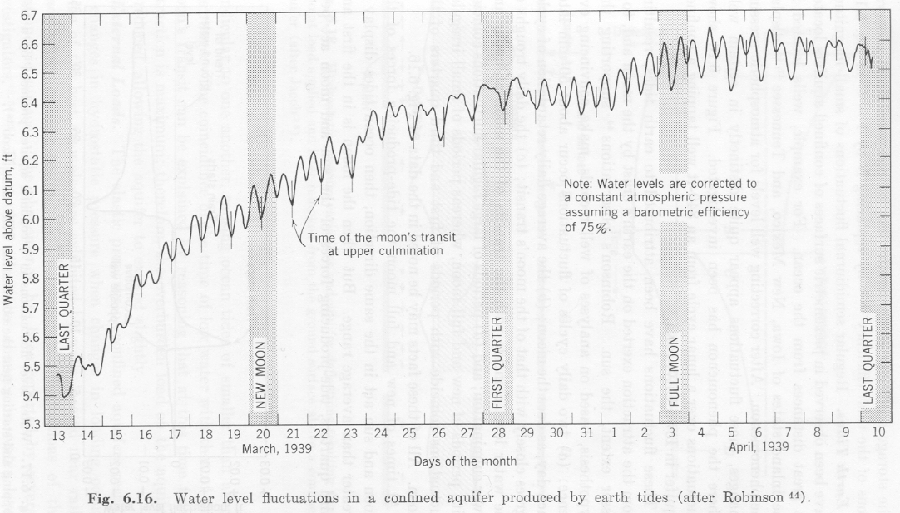
First-ever registered earth tides

Slide 38
Storage coeffiicient values
Water table aquifer
Semi-confined aquifers
Specific yield S_{y} [-] ≈10%-25%
Elastic storage S [-] ≈ 0.0001 - 0.001
In water table aquifers, we generally neglect the contribution from elastic stroage, but it’s still there.
Sy/S≈100
S_{y} Depends on moisture profile
Only elastic storage S [-] ≈ 0.0001-0.001
Specic strorage coefficient S_{s} [1/L] ≈ 10⁻⁵ [1/m]

Slide 39
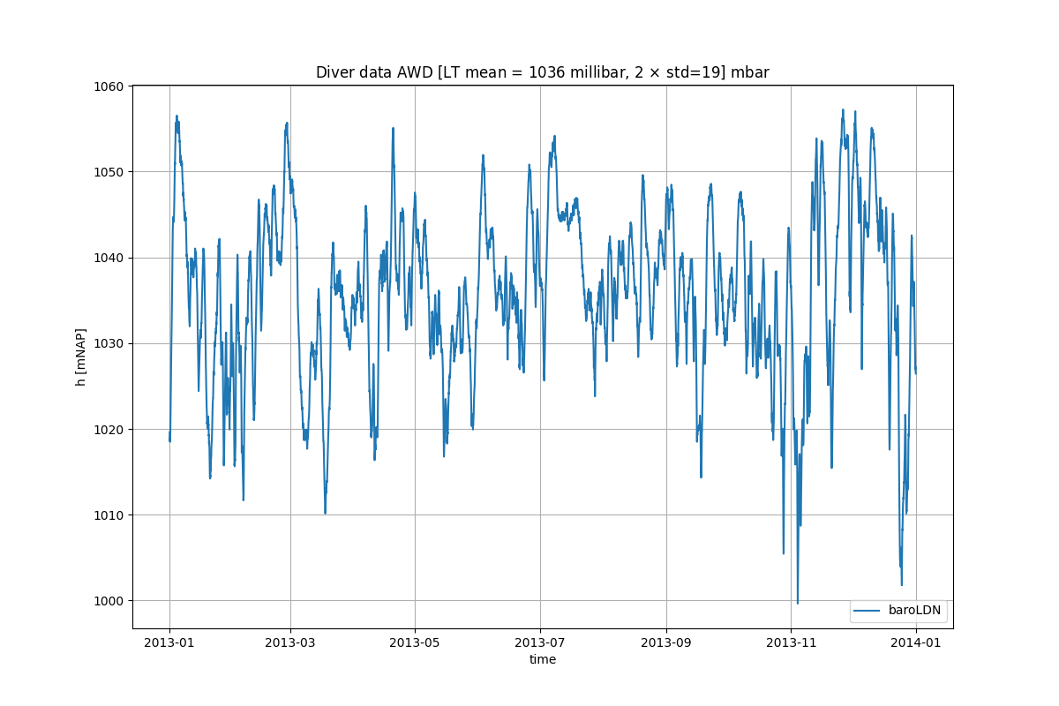
Barometer pressure during one year at Leiduin (Zandvoort)
≈ means: “in th order of”
2 std ≈ 0.4 m
≈ 0.2 m
≈ 0.2 m

Slide 40
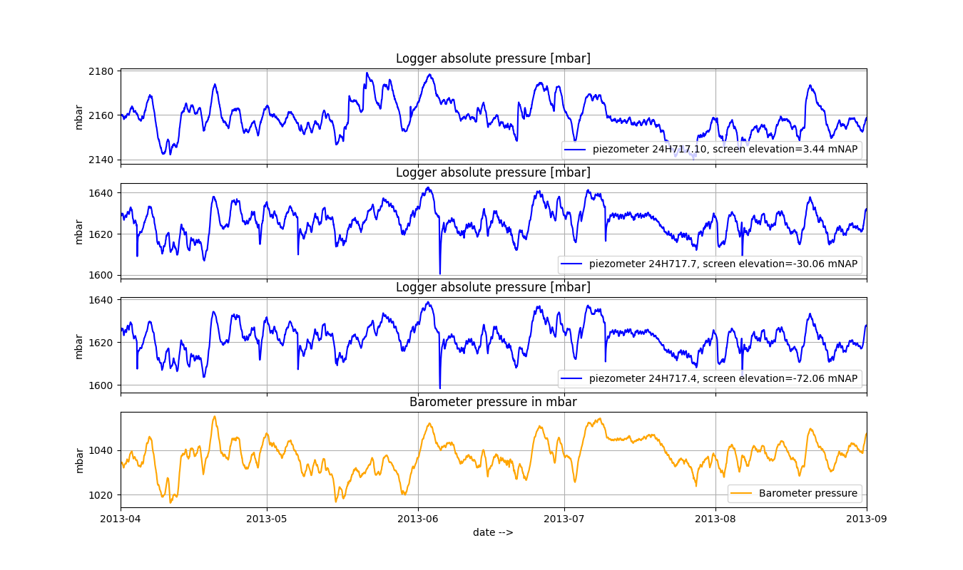
Piezometernest 24H717 + barometer Amsterdam Water Supply Dunes (Registered abs. pressures in mbar)
The barometer almost completely masks what’s going on in the groundwater
which you can conclude from the correlation with the barometer.

Slide 41
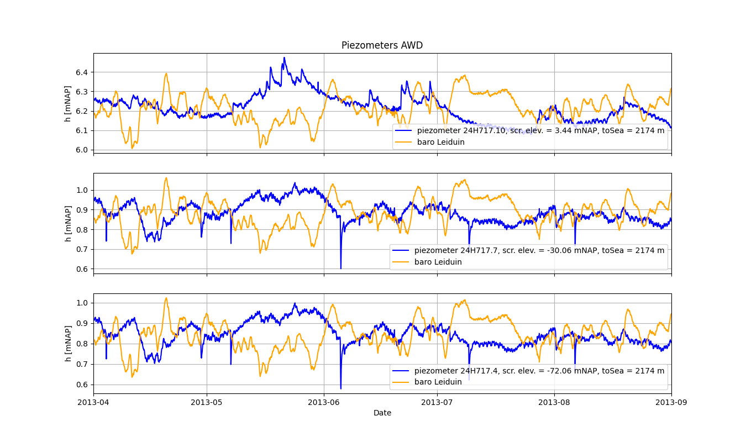
Piezometernest 24H717Amsterdam Water Supply Dunes (After subraction of barometer pressure convered to head. The barometer converted to m is also shown for comparison.)
Notice that we now have smooth curves showing
what happens in the suburface not in the air!

Slide 42
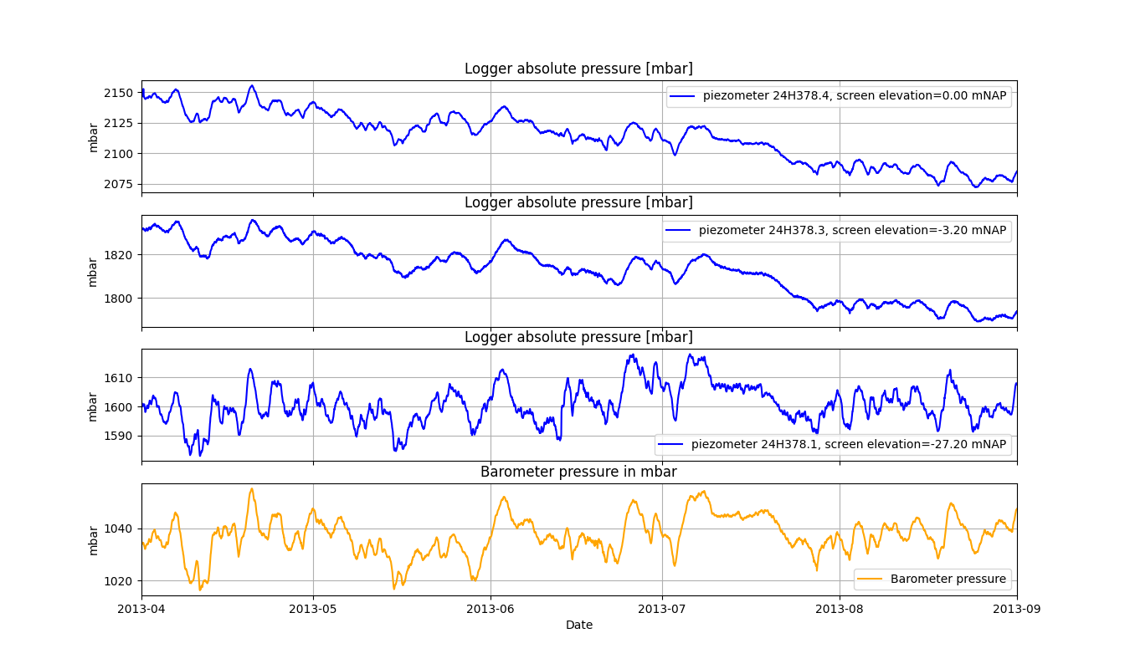
Piezometernest 24H378 + barometer Amsterdam Water Supply Dunes (Registered abs. pressures in mbar)
Notice the strong correlation with the barometer pressure

Slide 43
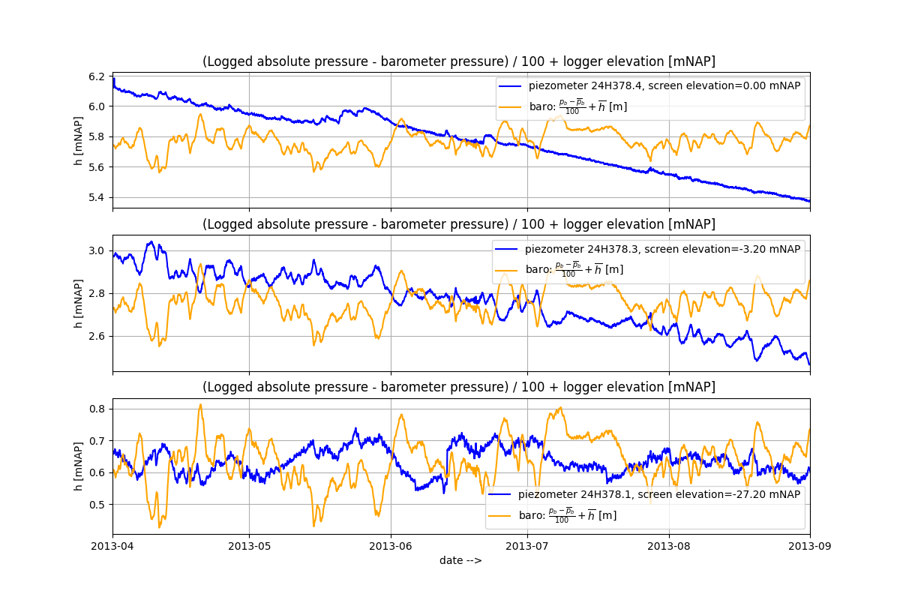
Piezometernest 24H717 After subttraction of barometer.
Notice the remaining (now inverted and smaller corrolcation) with the barom. Press. In piezom 3 (mid figure)
Also notice that the deeper piezometer does not have a visual correlation with the barometer!

Slide 44
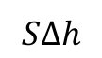
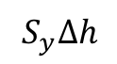
Notice the large difference in amount of water drained from a phreatic and a confined aquifer for the same drawdown illustrated in this slide. The difference is about a factor of 100.
Phreatic aquifer
Confined aquifer
Initial water table
Initial head
Final water table
Drawdown
Final head
About 200 mm per m drawdown
About 1 mm per m drawdown
impervious
impervious
$$S_{y}Δh$$
Amount drained
$$SΔh$$

Slide 45
Key questions
Can you derive the elastic storage coefficient of aquifers?
Same for barometric efficiency?
Same for effect of overburden change?
How do barometric efficiency and overburden efficiency relate to each other?
How can specific storage coefficient be derived from measured barometric efficiency?
How does specific storage relate to elastic storage of an aquifer?
Have any idea of values of specific storage found in practice?
Same for specific yield of sand?
What is the dimension of specific yield S_{y}, specific storage S_{s} and elastic storage S?
Which of the two is largest (specific yield or elastic storage, and how much larger?)
For the cracks: could you derive the effect of earth tide on groundwater head?

Slide 46
Further see
See section 4.2.7 of the syllabus
See the old exams bundle

